Slide 1
Objectives
In this session, you will learn to:
Use variables in C++ programs
Write and execute C++ programs

Slide 2
Variables and Data Types
Variables are named locations in memory that contain specific values.
Rules for Naming Variables in C++
    Should not have any embedded spaces or symbols
    Should be unique
    Must begin with a letter or an underscore, which may be followed by a sequence of letters, digits, or underscores
    Should not be a keyword

Slide 3
Data Types
Define the type of data that can be stored in a variable.
Built-in data types are:
  char - For characters and strings
  int - For integers
  float - For numbers with decimals

Slide 4
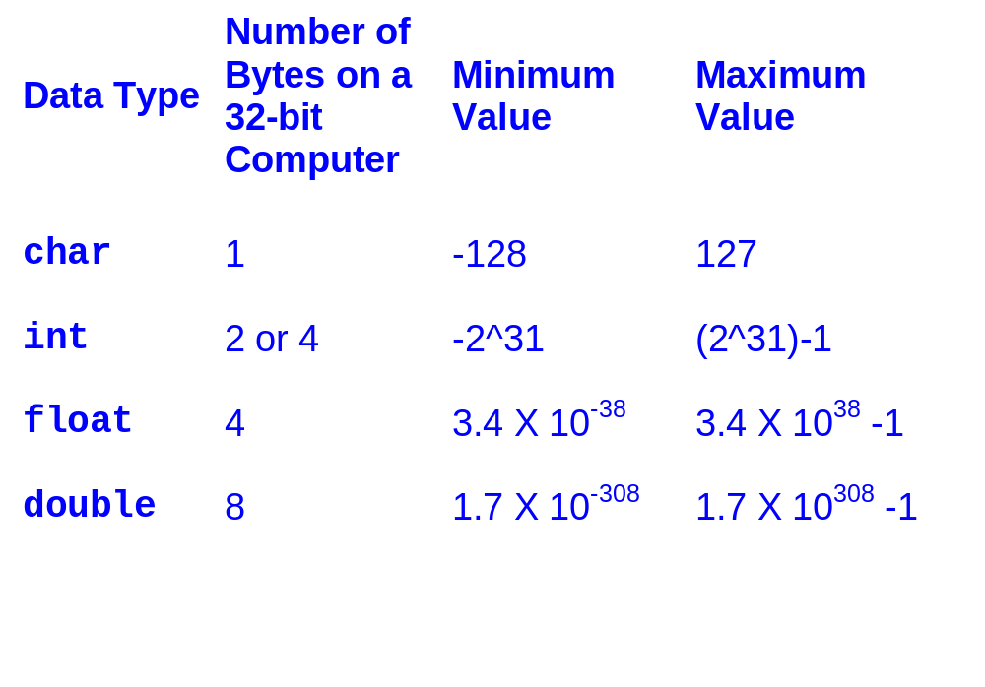
Data Types (Contd.)

Slide 5
Type Modifiers
You can modify the default range of the built-in data types. To achieve this, C++ provides you with the following type modifiers:
  long
  short
  signed
  unsigned

Slide 6
Integer Type Modifiers
You can prefix an int declaration with the short modifier.
The size of a short int is two bytes.
Similarly, you can apply long to int to increase the range of the int variable.
Character Type Modifiers
You can declare char data types as signed or unsigned.
The range of a signed char data type is -128 to 127, whereas, the range of an unsigned char data type is 0 to 255.

Slide 7
Member Variables
Are used to implement attributes in C++.
Are declared inside the class body.
Example:
class Car
  {
  float price;
  };

Slide 8
Accepting and Storing Values in Member Variables
The cin object is used to accept input from the user.
Example:
class Car
  {
  float price;
  public:
  void acceptprice()
  {
  cout << “Enter Price :”;
  cin >> price;
  }
};

Slide 9
Cascading of I/O Operators
Multiple output operators can be used in the same cout statement, as shown in the following code snippet:
  cout<< “The result of 11 X 11 is : ” << 11 * 11;
Multiple input operators can be used in the same cin statement, as shown in the following code snippet:
  cout << “ Enter English, Math, and Science Scores : ” ;
  cin >> English_score >> Math_score >> Science_score;
This reduces code lines and increase readability.

Slide 10
Constants in C++
They are data items whose values do not change during the execution of a program.
They are also called as literals.
C++ includes the following constants (literals):
  Integer constants
  Character constants
  Floating constants
  String literals

Slide 11
Constants in C++ (Contd.)
Integer constants:
  Numbers that do not have any fractional part are known as integer constants.
  Integer constants may be signed or unsigned.
  Some valid examples of integer constants are:
    5
    +45
    -100

Slide 12
Constants in C++ (Contd.)
Character constants:
  Characters enclosed within single quotes are known as character constants.
  Such constants are of char type.
  Some valid examples of character constants are:
    ‘A’
    ‘s’
    ‘N’
    ‘5’

Slide 13
Constants in C++ (Contd.)
C++ also includes certain character constants that cannot be displayed directly on the screen by using the keyboard.
For example, you cannot display a carriage return, backspace, or a backslash directly from the keyboard.
To display such a constant, you need to use an escape sequence, which is represented by a backslash (\) symbol followed by the constant.

Slide 14
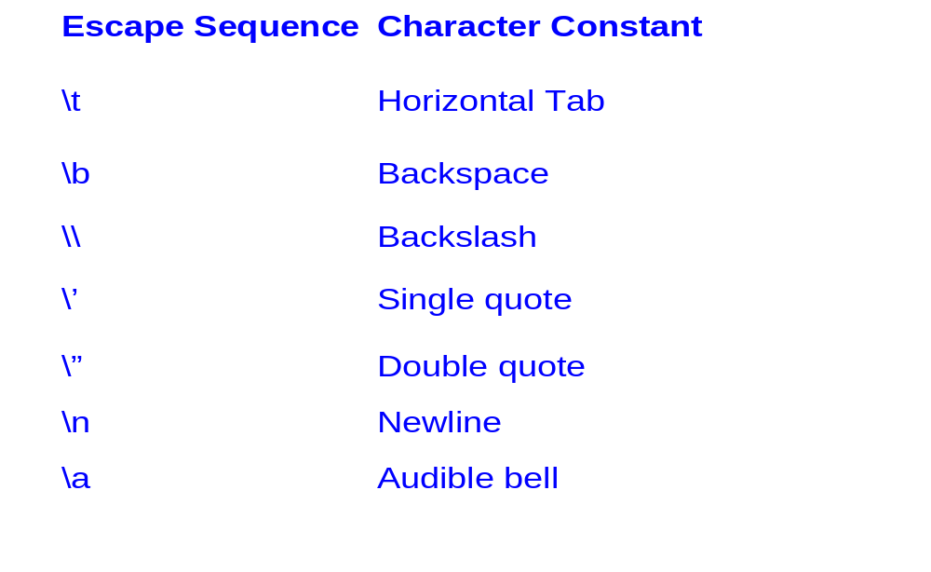
Constants in C++ (Contd.)

Slide 15
Constants in C++ (Contd.)
Floating constants:
  Numbers that have a fractional part are known as floating constants.
  Floating constants can be represented in either of the following forms:
    Fractional form
    Exponential form

Slide 16
Constants in C++ (Contd.)
String literals:
  They are represented by multiple characters enclosed within double quotes.
  They are character arrays, wherein, each character can be manipulated individually.
  When a string literal is stored, an additional character, \0, is concatenated to the literal. This special character is used to notify the compiler about the end of the literal.

Slide 17
Constants in C++ (Contd.)
The const keyword:
  Constant are defined by using the const keyword.
  The const keyword is an access modifier that sets the access property of a variable as read-only.

Slide 18
Components of a C++ Program
#include: It is called a preprocessor directive.
The iostream header file: The header files contain definitions of functions, classes, and predefined objects like cout and cin.
  #include<iostream.h>:The preprocessor directives process the header file before the program is compiled.
The main() function:
  Is mandatory in a C++ program.
  The program execution always starts from the main()function.

Slide 19
Displaying Formatted Output
C++ provides certain manipulators that can be used to format the output to be displayed on the screen.
One of the most commonly used manipulators provided by C++ is the setw() manipulator.
The setw()manipulator is used to set the width of the field that is to be displayed on the screen.
The following statement sets the width of the text “Bryan” to 10, therefore, 5 additional characters will be prefixed to the original 5 characters, and then the output will be displayed on the screen:
cout << setw(10) <<”Bryan”;

Slide 20
Introducing Functions
Functions are the building blocks of C++ programs.
A function groups a number of program statements into a single unit.
A group of functions together form a larger entity called a module.
Functions reduce the program size.
Any sequence of instructions that is repeated in a program can be grouped together to form a function. The function code is stored in only one place in the memory.

Slide 21
Introducing Functions (Contd.)
Function prototyping:
  Just as any variable is declared in a program before it is used, it is necessary to declare or prototype a function to inform the compiler that the function will be referenced at a later point in the program.
  The following code snippet gives a prototype of a function:
  void add();

Slide 22
Introducing Functions (Contd.)
Defining a function:
  The function definition contains the code for the function.
  A function declaration can be avoided if the function definition appears before the first call to the function.

Slide 23
Introducing Functions (Contd.)
Function arguments:
  Argument(s) of a function is/are the data that the function receives when invoked from another function.
  It is not always necessary for a function to have arguments.
  The add(int a, int b) function contain two integer arguments.

Slide 24
Introducing Functions (Contd.)
Returning values from functions:
  When a function completes its execution, it can return a single value to the calling program, which can be trapped when the calling function needs the result of the called function.
  The following code snippet illustrates a function that returns a value:
    int add(int iNum1, int iNum2)
    { return iNum1+iNum2;
    }

Slide 25
Introducing Functions (Contd.)
Default arguments:
  C++ allows a function to assign a default value to a parameter when no argument corresponding to that parameter is specified in the call to that function.
  A function that assigns default arguments is illustrated in the following code snippet:
    int add(int iNum1=10, int iNum2=20)
    { return iNum1+iNum2;
    }

Slide 26
Introducing Functions (Contd.)
Constant arguments:
  To make an argument as constant, you need to use the const keyword.
  For example, if you want that the integer arguments accepted by the add()function should be constants, you can modify the declaration as:
  int add(const int iVar1, const int iVar2);

Slide 27
Creating Objects
A class declaration does not reserve memory at the time of declaration.
Memory is allocated when an instance of the class is created.
An instance of a class is called an object.
All the objects share the same copy of the member functions, but maintain a separate copy of the member variables.
All the objects share the same copy of the member functions, but maintain a separate copy of the member variables.

Slide 28
Compiling, Linking, and Executing a Program
Is done by following the listed steps:
1. The C++ program should contain the #include statement, the class declaration and member function definition, and the main() function.
2. Save the file with a .cc extension.
3. Compile the file using the gpp <file name> command from the command prompt.
4. Execute the file using the a.out command from the command prompt.

Slide 29
Compiling, Linking, and Executing a Program (Contd.)
Identifying errors:
  An erroneous program will not compile.
  Some of the common types of errors are:
    Syntax errors
    Semantics errors
    Logical errors
    Type errors
    Run-time errors

Slide 30
Compiling, Linking, and Executing a Program (Contd.)
Syntax errors:
  Syntax refers to the rules that govern the structuring of statements in a language.
  The program should be syntactically correct.
Semantic errors:
  Semantic errors are those that are caused because of statements that are not meaningful.

Slide 31
Compiling, Linking, and Executing a Program (Contd.)
  Semantic refers to the meaning of a statement. The statement that you write may be syntactically correct, but if the meaning of the statement is not correct, a semantic error will be raised by the compiler.
Logical errors:
  Logical errors are caused by statements that generate undesirable or unpredicted outputs.

Slide 32
Compiling, Linking, and Executing a Program (Contd.)
  Type errors:
  Type errors are caused when you pass a type of value that is different than the one that is expected by the program.
  Run-time errors:
  Run-time errors occur while the program is executing.
  Such errors are a result of certain illegal operations.

Slide 33
Summary
In this session, you learned that:
A variable is a named location in memory that contains a specific value.
A data type defines the type of data that can be stored in a variable.
The cin object is used to accept input from the keyboard.
The cout object is used to display output to the screen.
The contents of header files are inserted into a program with the #include directive.

Slide 34
Summary (Contd.)
The C++ program execution starts from the first statement of the main()function.
The smallest element of a program understandable by the C++ compiler is known as a token.
Literals are data items whose values do not change during the execution of a program.
The setw()manipulator is used to set the width of the field that is to be displayed on the screen.
Comment entries are notes that a programmer writes anywhere in the code so that any programmer reading the code will understand it better.

Slide 35
Summary (Contd.)
An object is an instance of a class.
The compiler is a software that translates a program written in a language like C++ into machine language and the file containing the translated program is called the object code of your program.
Linking combines your object code with the object code of the functions you use and adds some standard startup code to produce a run-time version of your program.

Slide 36
Summary (Contd.)
Some of the common types of errors are categorized as:
  Syntax errors
  Semantics errors
  Logical errors
  Type errors
  Run-time errors

